Slide 1
Object Detection in Driver Assistance Systems
By: Khush Lalchandani

Slide 2
Abstract
This presentation covers three studies on different methods in Advanced Driver Assistance Systems (ADAS) The first study by focuses on real-time traffic sign recognition using deep convolutional neural networks. The second study by Harshitha discusses a real-time pedestrian detection system utilizing HOG features and SVM classifiers. The third study presents an RFID-based system for traffic light recognition, using an alternative approach to traditional image processing techniques.

Slide 3
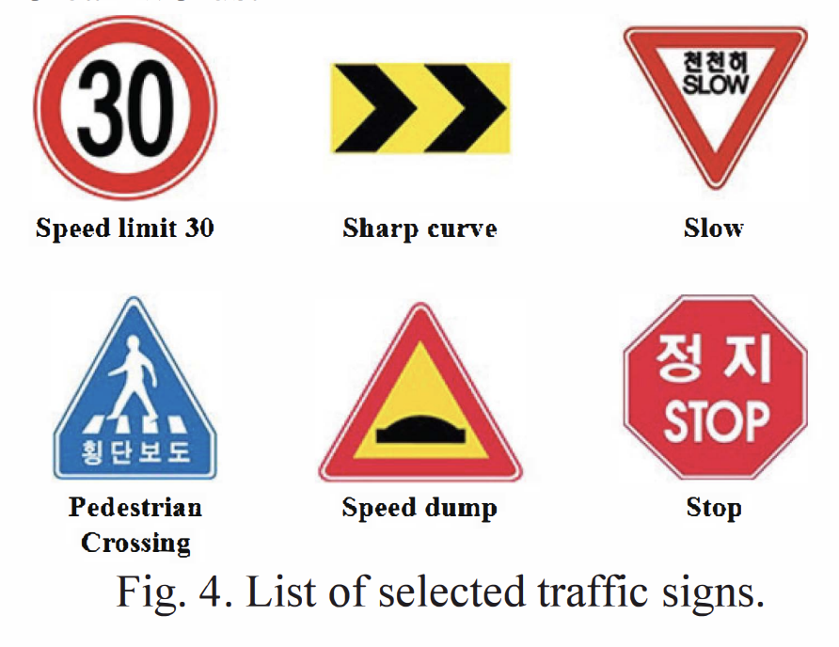
Real-time Traffic Sign Recognition System with Deep Convolutional Neural Network
Objective: Develop a real-time traffic sign recognition system
Utilize deep convolutional neural networks (CNN) for sign detection
Implement the system in an autonomous vehicle

Slide 4
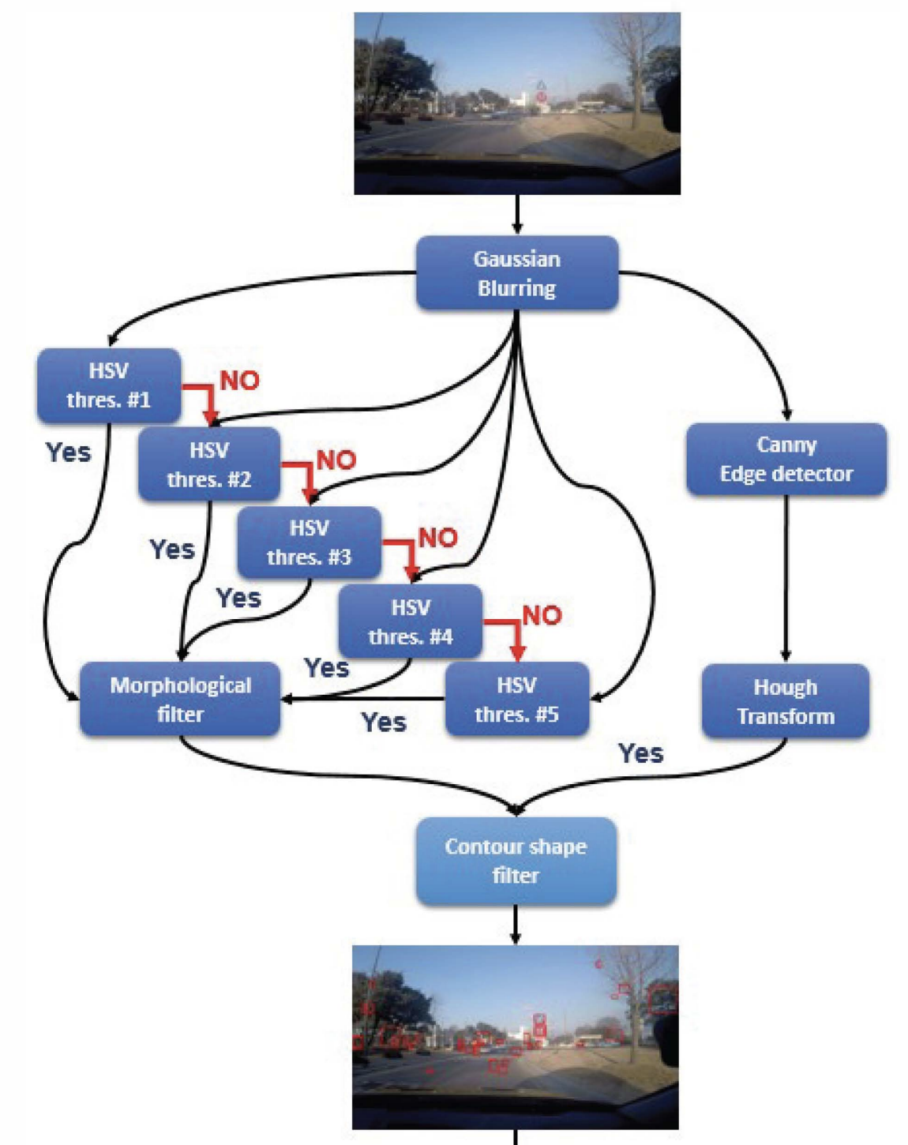
Methodology
Gaussian filter and Canny edge detection are used to find regions
Hough transformation is used to detect distinct shapes
Images are resized to 100 x 100 for quicker processing

Slide 5
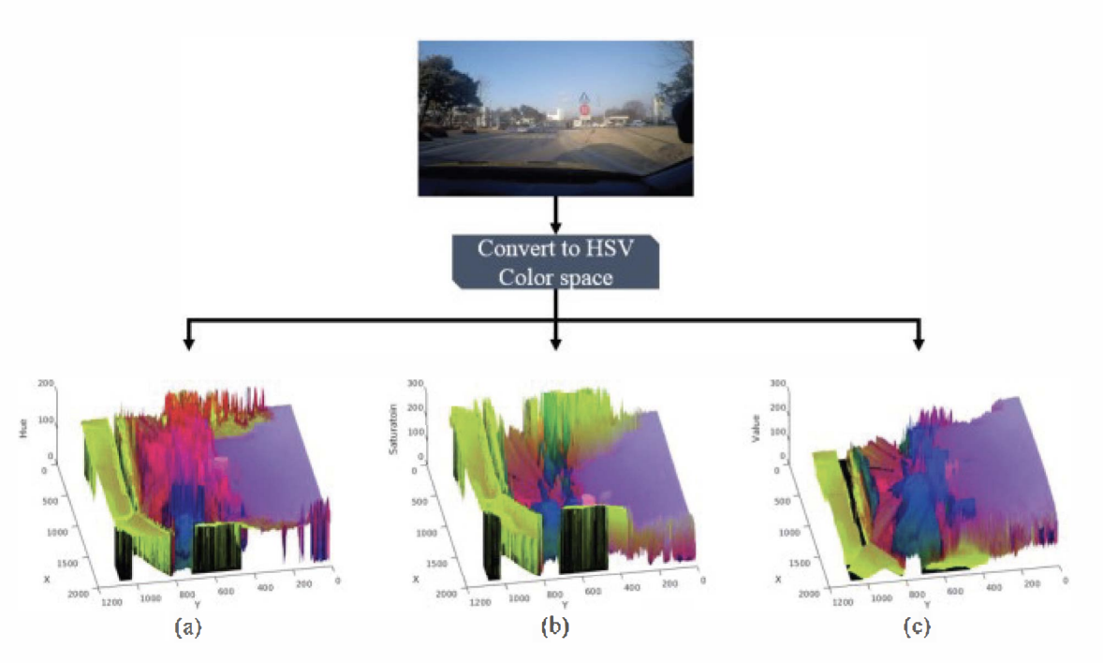
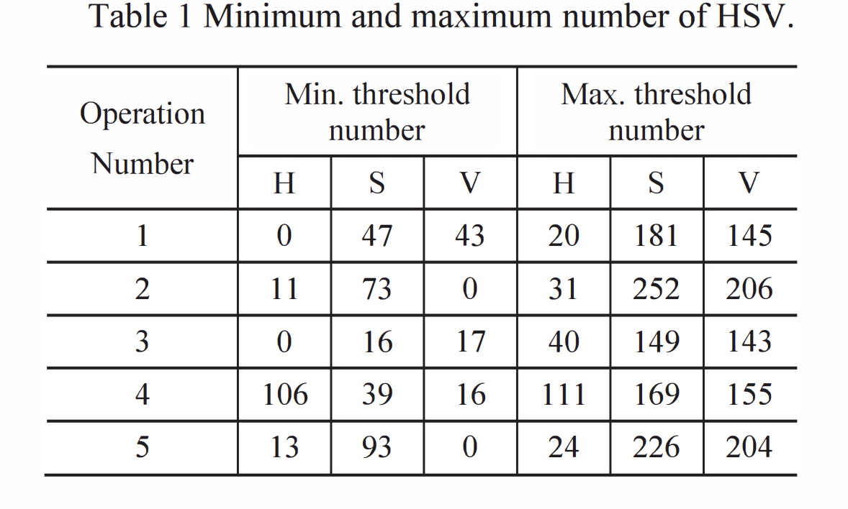
Methodology
Training on Korean traffic signs using LeNet-5 CNN architecture
Color-based segmentation and HSV transformation for candidate region extraction
Use of light-weight algorithms for real-time performance

Slide 6
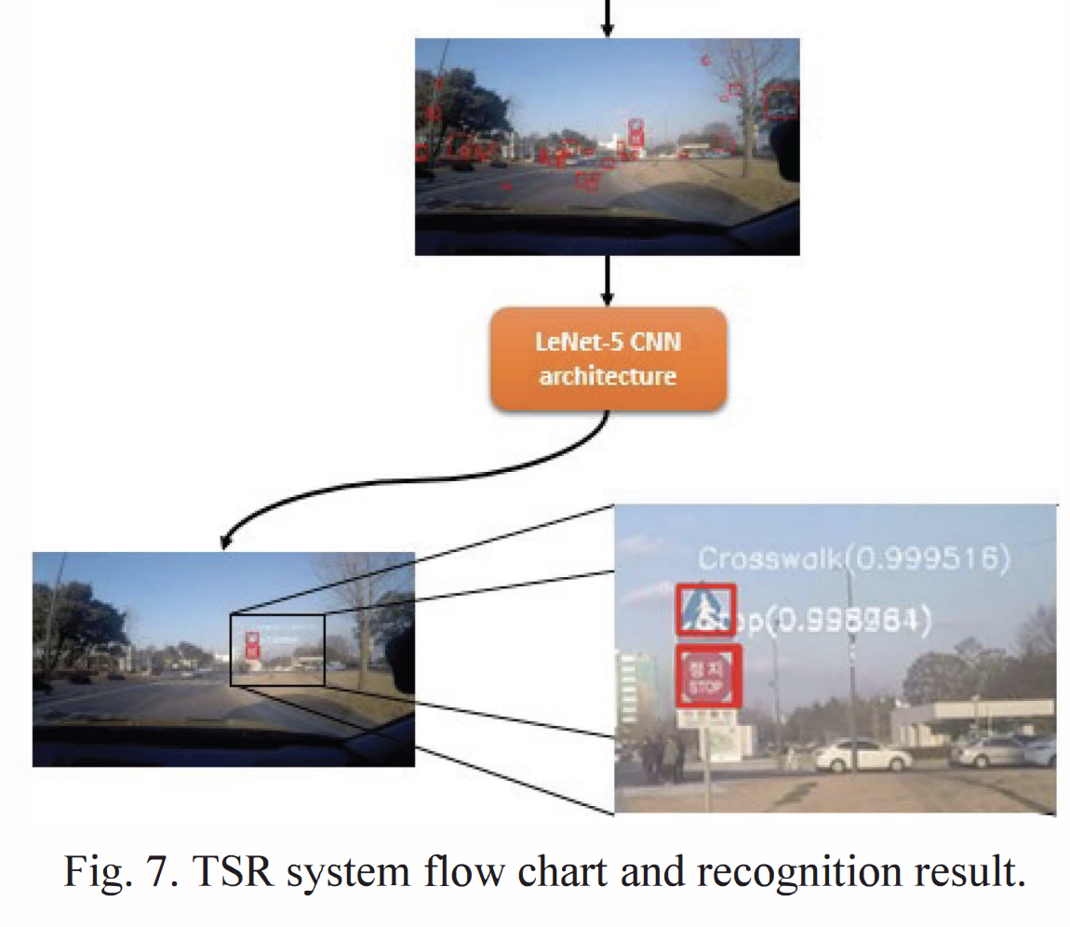
Results and Findings
Achieved successful recognition of 16 different traffic signs during real-time tests
Average recognition speed was 16.9 frames per second
High accuracy in varied lighting conditions and real-world scenarios

Slide 7
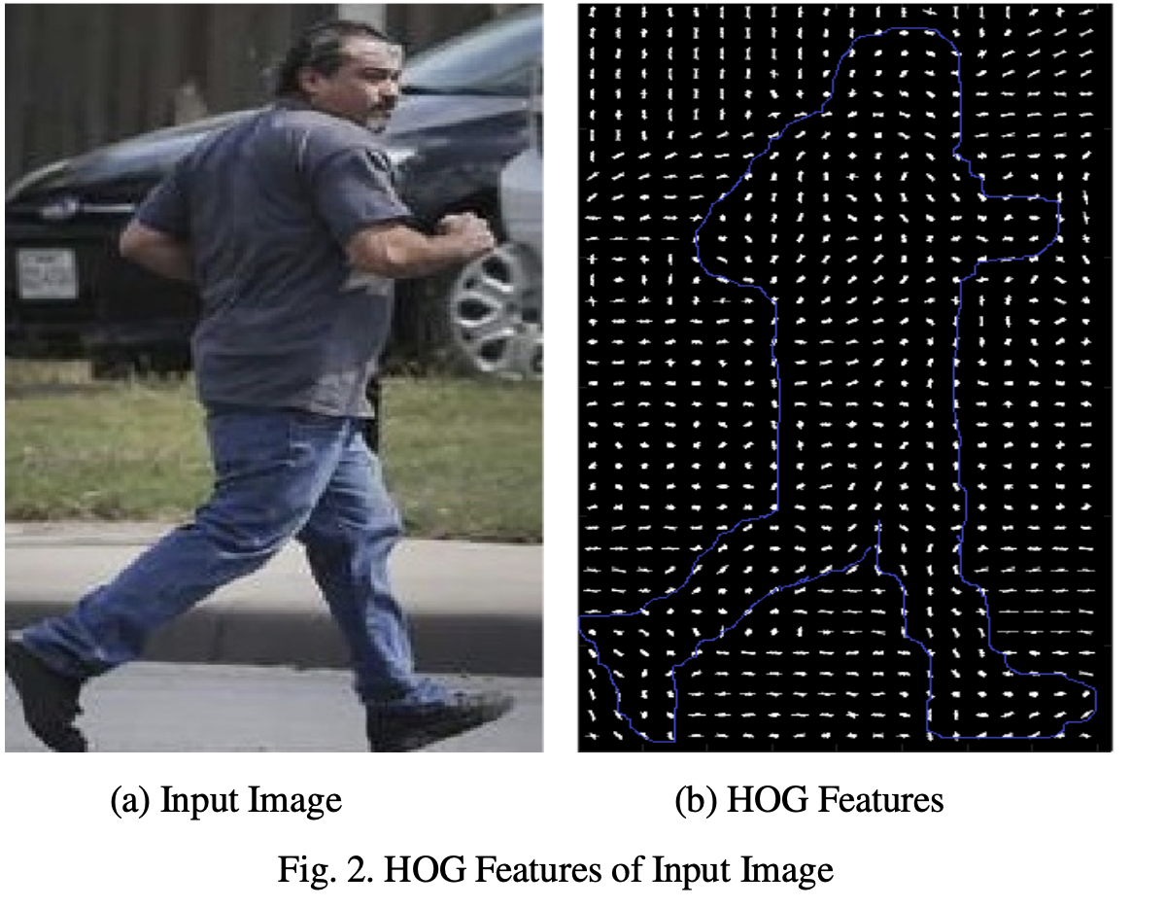
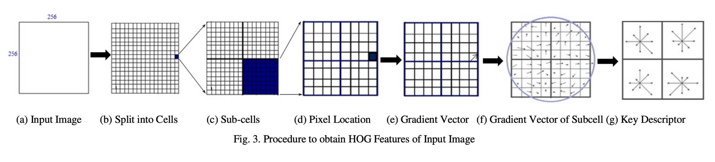
Design of a Real-time Pedestrian Detection System
for Autonomous Vehicles
Objective: Design a real-time pedestrian detection system
Histograms of Oriented Gradients (HOG) to find features from video frames

Slide 8
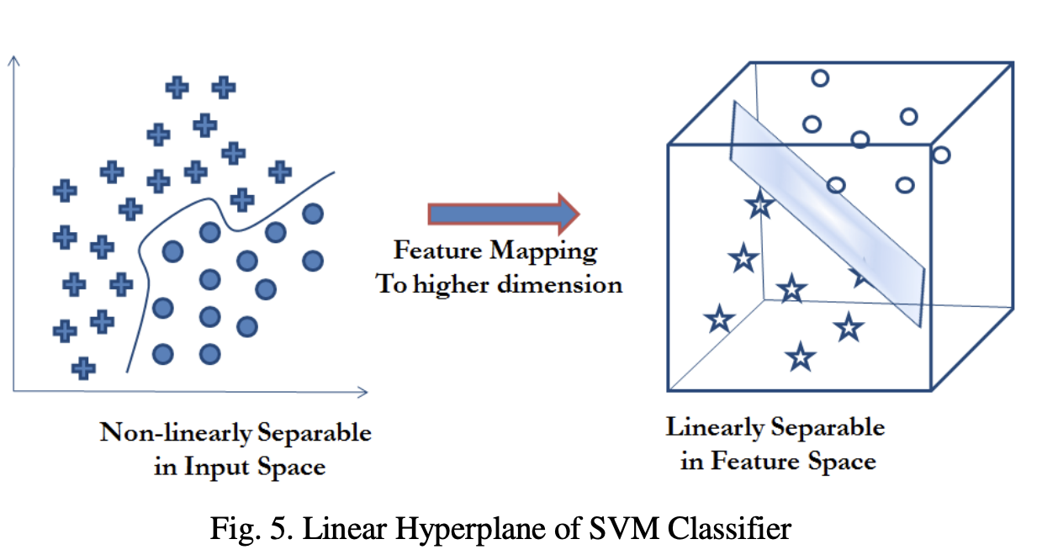
Methodology
Support Vector Machine (SVM) classifier for distinguishing pedestrians
SVM learning aims at finding a good hyperplane in a higher dimensional feature space

Slide 9
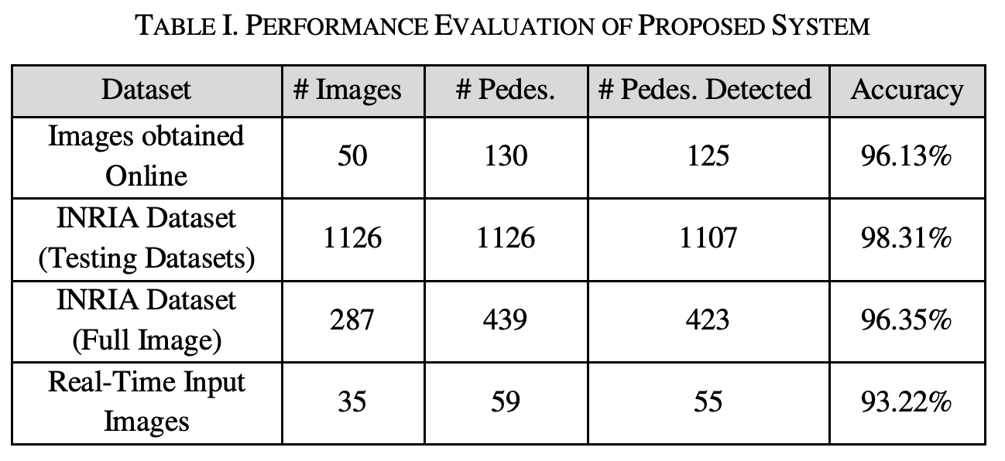
Results and Findings
98.31% accuracy using INRIA Person Dataset
Achieved 100% recognition accuracy for pedestrians near the vehicle
Good performance in both offline images and real-time video inputs

Slide 10
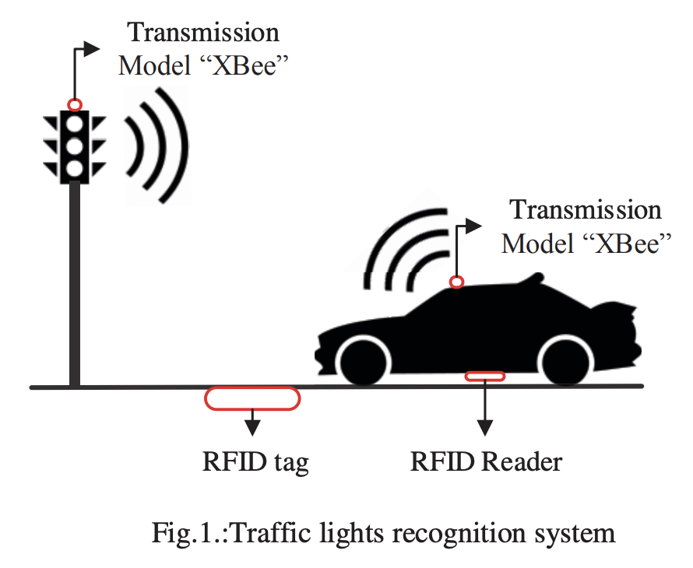
Traffic Lights System Based on RFID for Autonomous Driving Vehicle
Objective:Create an RFID-based system for recognizing traffic light statuses without using image processing-based recognition systems

Slide 11
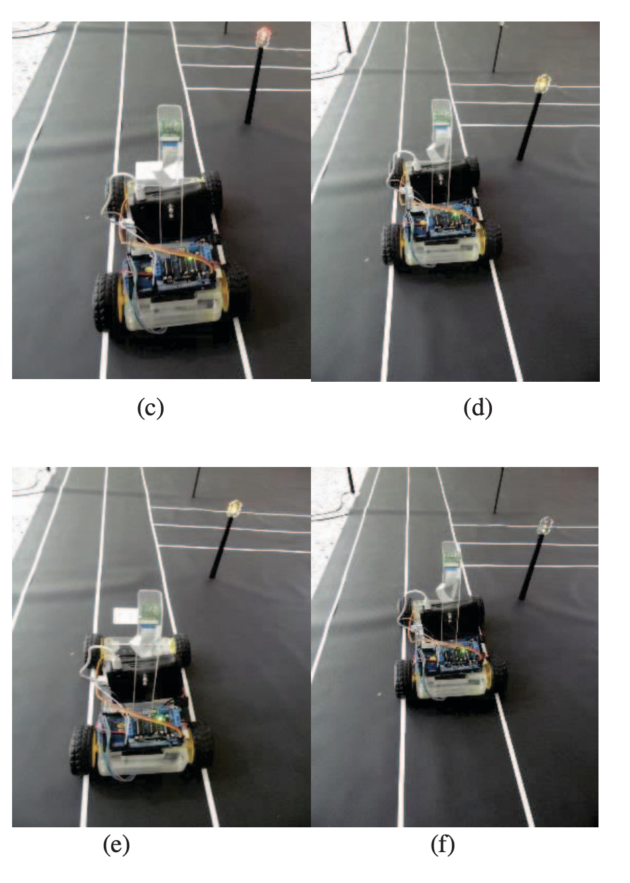
Methodology
Use of RFID tags and readers for signal detection
XBee modules for data exchange between traffic lights and vehicles

Slide 12
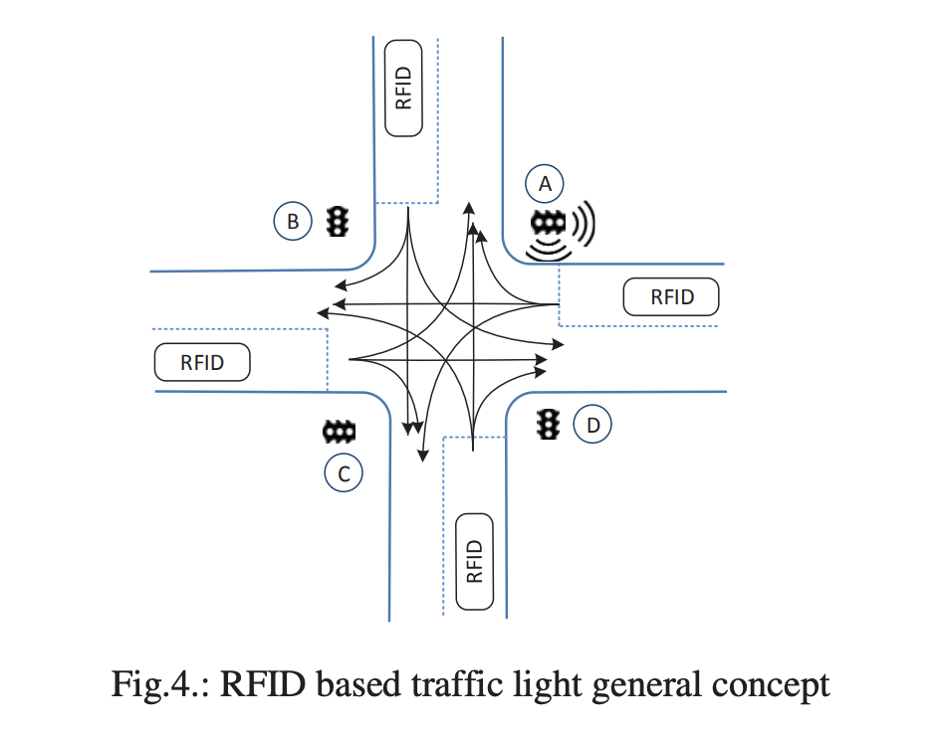
Results and Findings
Successful experimental validation with high recognition accuracy.
Low-cost and efficient system and performs well under various conditions

Slide 13
Conclusion and Future Research
Summary: The three studies contribute to the advancement of advanced drivers systems by improving challenges in traffic sign recognition, pedestrian detection, and traffic light recognition.
Future Research:
Using multi-sensor data for enhanced detection accuracy
Exploration of advanced machine learning models for real-time applications

Slide 14
References
S. Jung, U. Lee, J. Jung and D. H. Shim, "Real-time Traffic Sign Recognition system with deep convolutional neural network," 2016 13th International Conference on Ubiquitous Robots and Ambient Intelligence (URAI), Xi'an, China, 2016, pp. 31-34, doi: 10.1109/URAI.2016.7734014. keywords: {Out of order;Automobiles;TSR (Traffic Sign Recognition);CNN (Convolutional Neural Network);Real-time Image Processing;Autonomous Vehicle},
R. Harshitha and J. Manikandan, "Design of a real-time pedestrian detection system for autonomous vehicles," 2017 IEEE Region 10 Symposium (TENSYMP), Cochin, India, 2017, pp. 1-4, doi: 10.1109/TENCONSpring.2017.8069981. keywords: {Real-time systems;Support vector machines;Feature extraction;Autonomous vehicles;Cameras;Kernel;Computer vision;Autonomous Vehicles;HOG Features;Pedestrian Detection},
A. Ali and H. A. Hussein, "Traffic lights system based on RFID for autonomous driving vehicle," 2017 Annual Conference on New Trends in Information & Communications Technology Applications (NTICT), Baghdad, Iraq, 2017, pp. 122-127, doi: 10.1109/NTICT.2017.7976149. keywords: {Roads;RFID tags;Robots;Automobiles;Market research;Communications technology;RFID;traffic lights recognition;smart city;road signs detection;autonomous driving vehicle},

